Slide 1



BUILDING RESILIENCY &
INCREASING PROTECTIVE FACTORS
Practical tools for regulating stress and strengthening support
Genevieve Glaser, Be Well Iredell

Slide 2



BE WELL IREDELL
Education and Training helping people understand mental health, resilience, and prevention
Community Engagement building connection and reducing isolation
Access to Support and Care helping people actually find the resources they need when they need them

Slide 3
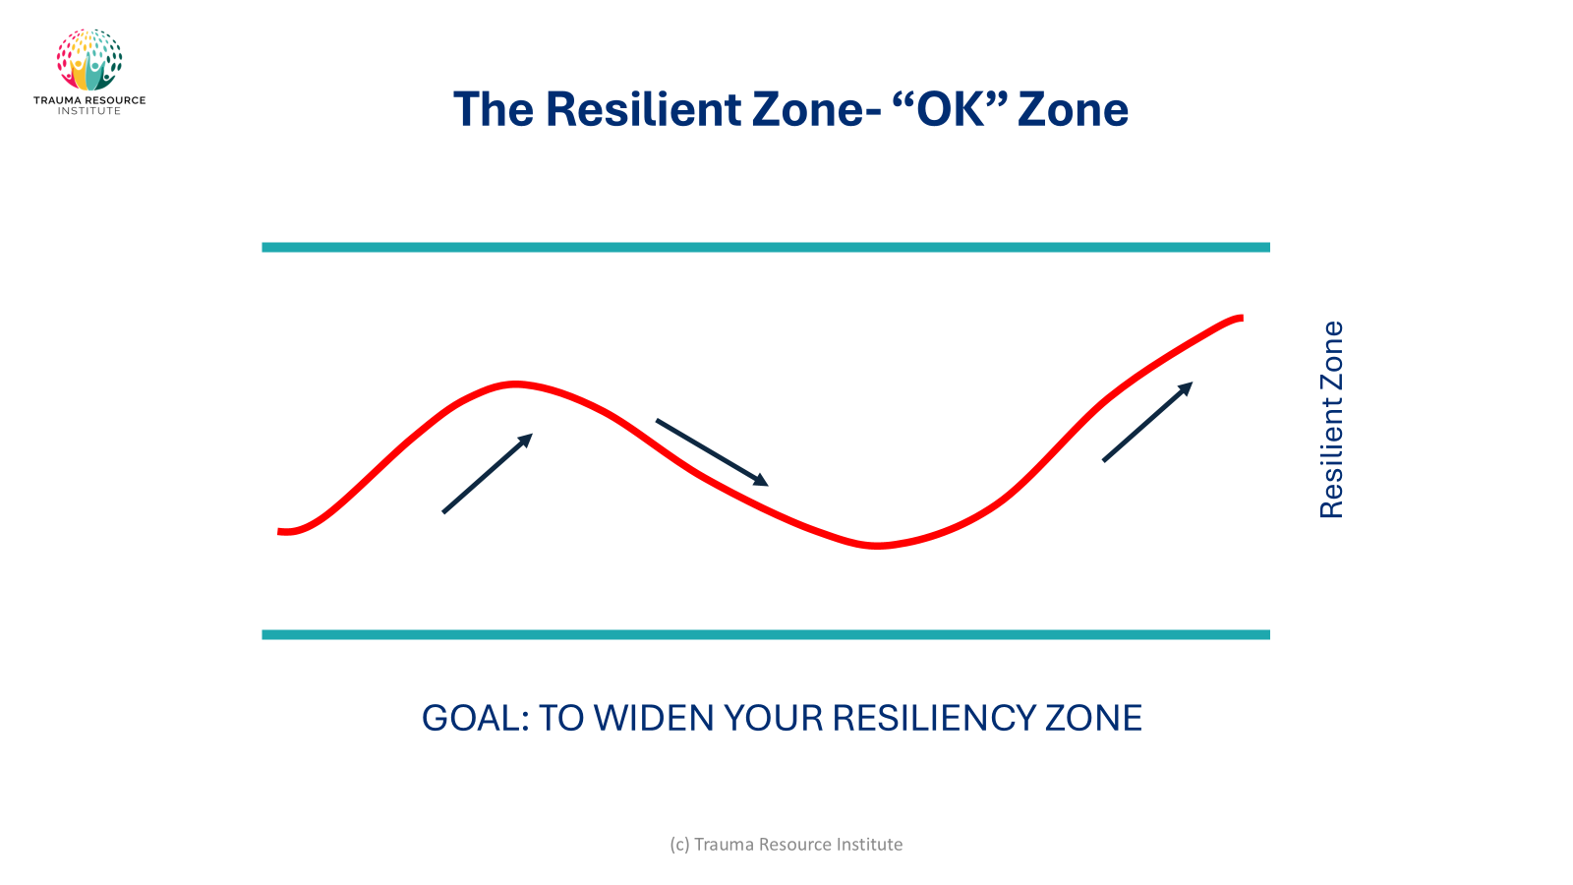
RESILIENT ZONE
INSIDE THE ZONE
OUTSIDE THE ZONE
  CLEAR THINKING
  CONNECTION
  PROBLEM SOLVING
  OVERWHELM
  REACTIVITY
  SHUTDOWN

Slide 4
RESILIENCE TOOLS
Simple regulation Tools
RESOURCES
HELP-NOW
GROUNDING
  A person
  A place
  A memory
  Breathing
  Sip Water
  Take a Walk
  Notice
  Press or Hold
  Focus

Slide 5
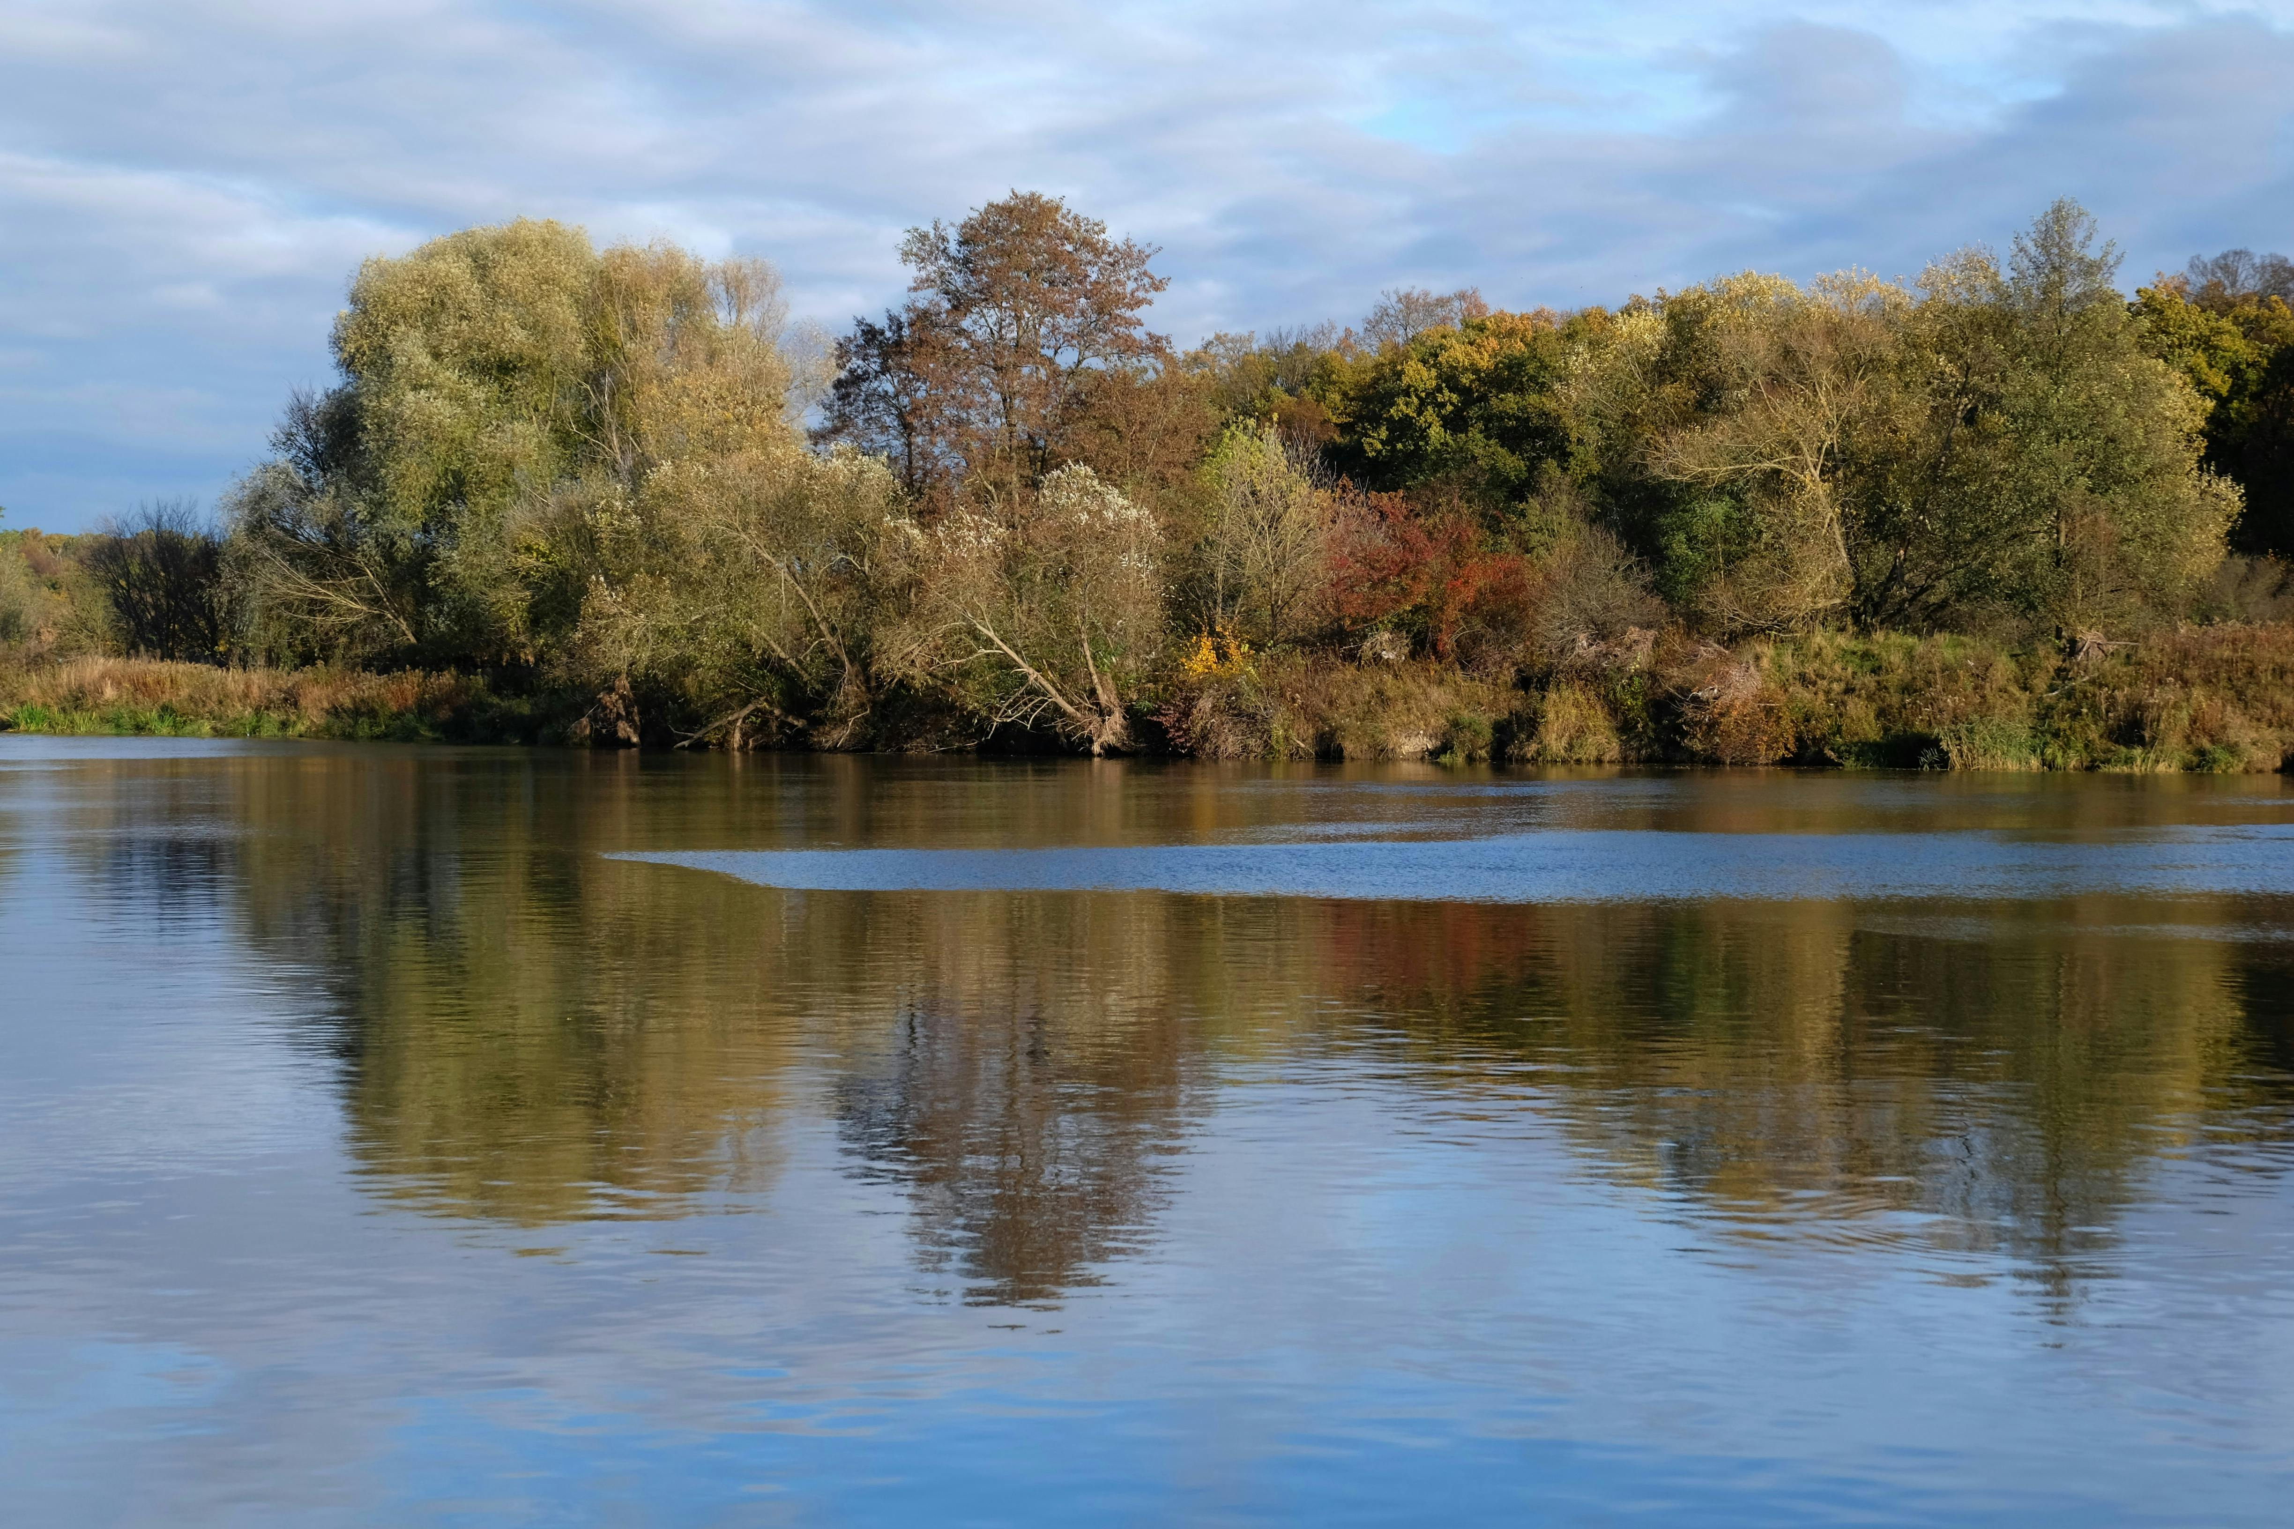
RESILIENCE IS SUPPORT
The heaviness isn’t the problem.
Carrying it alone is.

Slide 6

THANK YOU
To Learn More About Be Well Iredell
Contact Genevieve at
GGLASER@UWIREDELL.ORG

