Slide 1
What’s in Store?
Legal Substances in Local Retail Settings
Kristin Blumenstein
Kelly V. Teague, CPS
March 10, 2026

Slide 2
Objectives:
Define Environmental Scans
Review DACI’s Environmental Scan
Define products and compounds
Outline Effective Strategy Implementation

Slide 3
Disclaimer/Credit
This presentation was created using information from the Alcohol Policy Resource Center’s Environmental Scan toolkit and the Standardized Tobacco Assessment for Retail Settings tool
Gas Station Pharmacology slides are taken from Prime For Life Legal Loopholes & Current Trends 9/11/2025
The views expressed in this presentation are independent of DACI

Slide 4
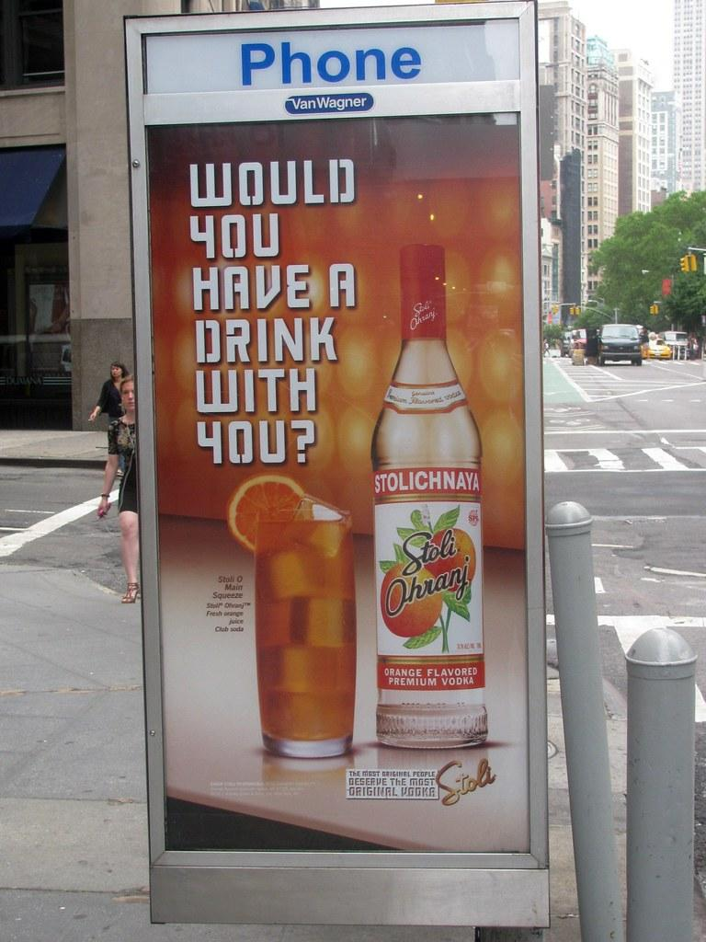
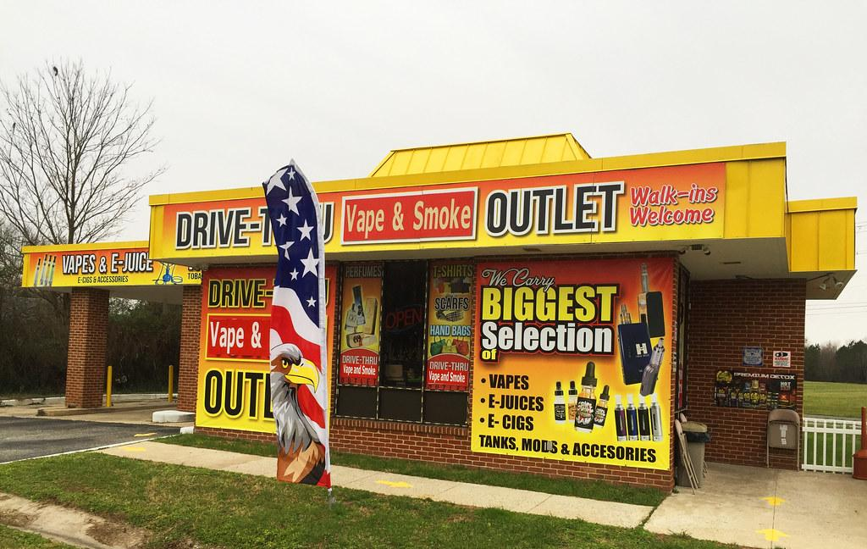
Environmental Scans
What is an environmental scan?
“...a process that systematically surveys and interprets relevant data to identify external opportunities and threats that could influence future decisions.” -SHRM
Notes:
A systematic process that surveys and interprets relevant data to identify risk and protective factors that may contribute to future decision-making

Slide 5
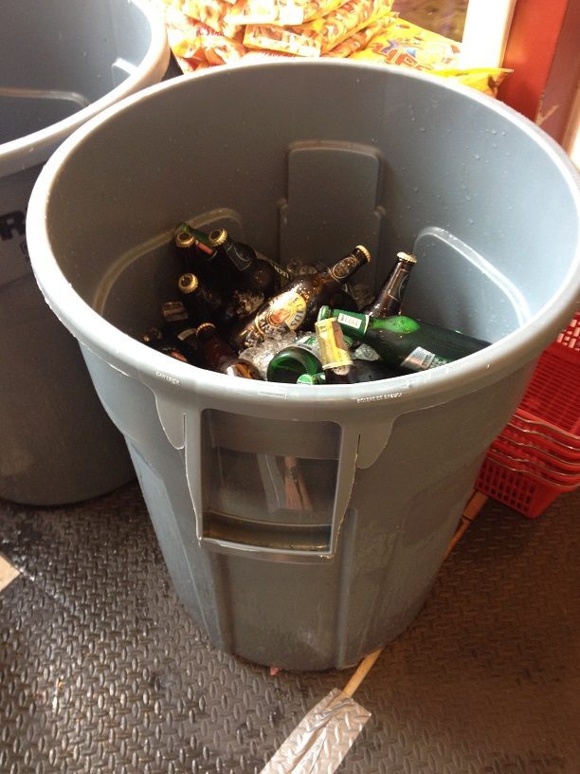
Why do we conduct environmental scans?
To Collect Data
To Prove a Point/Build A Case
To Include/Empower Youth

Slide 6

Strategic Prevention Framework
Where does it fit?
Assessment
Capacity Building
Planning
Evaluation

Slide 7
Outcome/Output
Outcomes:
Capacity Building
Change In Physical Appearance
Policy
Outputs:
# sites scanned
# volunteers recruited for scanning
# formal complaints made

Slide 8
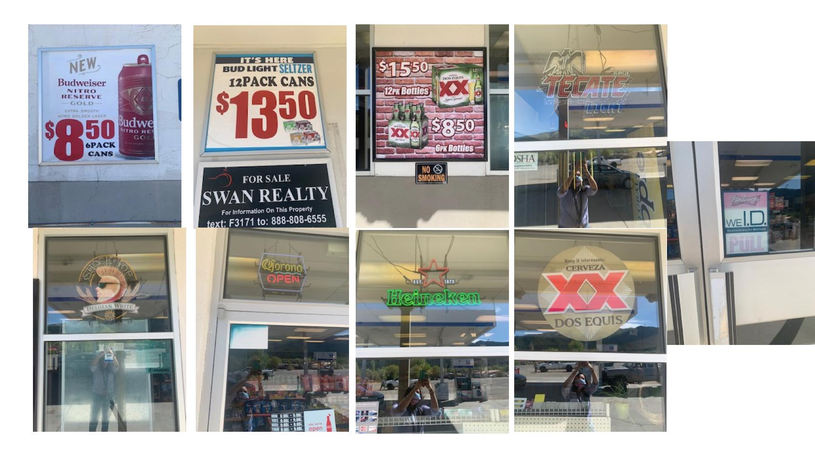
The Process
Environmental Scanning
Notes:
1. Recruit participants (ideally youth)
2. Identify retail outlets/sites to be targeted (think about your alcohol purchase surveys, social media, what resonates with your volunteers)
3. Train participants (in person, rules, empowerment)
4. Implement (two sets of eyes, documentation, streamlined process specific to community)
5. Debrief participants (what worked, what didn’t, what should be changed for next time)
6. Highlight initiative in local media outlets and social media. (make necessary formal complaints, present to stakeholders, decide on what could happen as a result of your findings)

Slide 9

Mediums
Social Media
Social Networking
LE “fan pages”/Alcohol Related Groups
Physical Sites
Community At Large “day in the life”
Fairs/Events

Slide 10

Caveats
Different Substances=Different Protocol
How will you package/present findings
ID What you want to accomplish with the strategy (what is this helping you satisfy?)

Slide 11
4 P’s
Price
Product
Promotion
Placement
Is alcohol cheaper than non-Alcohol like water/soda?
Are larger quantities cheaper than smaller quantities?
How much are the taxes?
What is the single pack/item price? (tobacco products)
How much are menthol cigarettes compared to non-menthol cigarettes?
Are single units sold?
Are high-content alcoholic beverages served?
Do they sell caffeinated alcoholic products?
Do they sell brands that are popular among youth?
Do they sell flavored products? (tobacco)
Do they advertise specials?
Are there displays related to holidays or events?
Are there displays in non-alcohol-related parts of the store?
Are gifts attached to alcohol or tobacco purchases?
Are there product ads within 3 feet of the floor?
Are products placed beside water/soda coolers?
Are products by the entrance/exit?
Are products on or beside the checkout counter?
Are products beside candy, toys, or ice cream?

Slide 12
Types of Scans
Physical Locations
OFF-PREMISE: GROCERY STORES, GAS STATIONS, ABC STORES, CONVENIENCE STORES, TOBACCO/VAPE SHOPS
ON-PREMISE:
RESTAURANTS, BARS
Advertising
ON/IN STORES, BILLBOARDS,
BUSES,
ETC.
Media Advertising
TV
RADIO
SOCIAL MEDIA

Slide 13

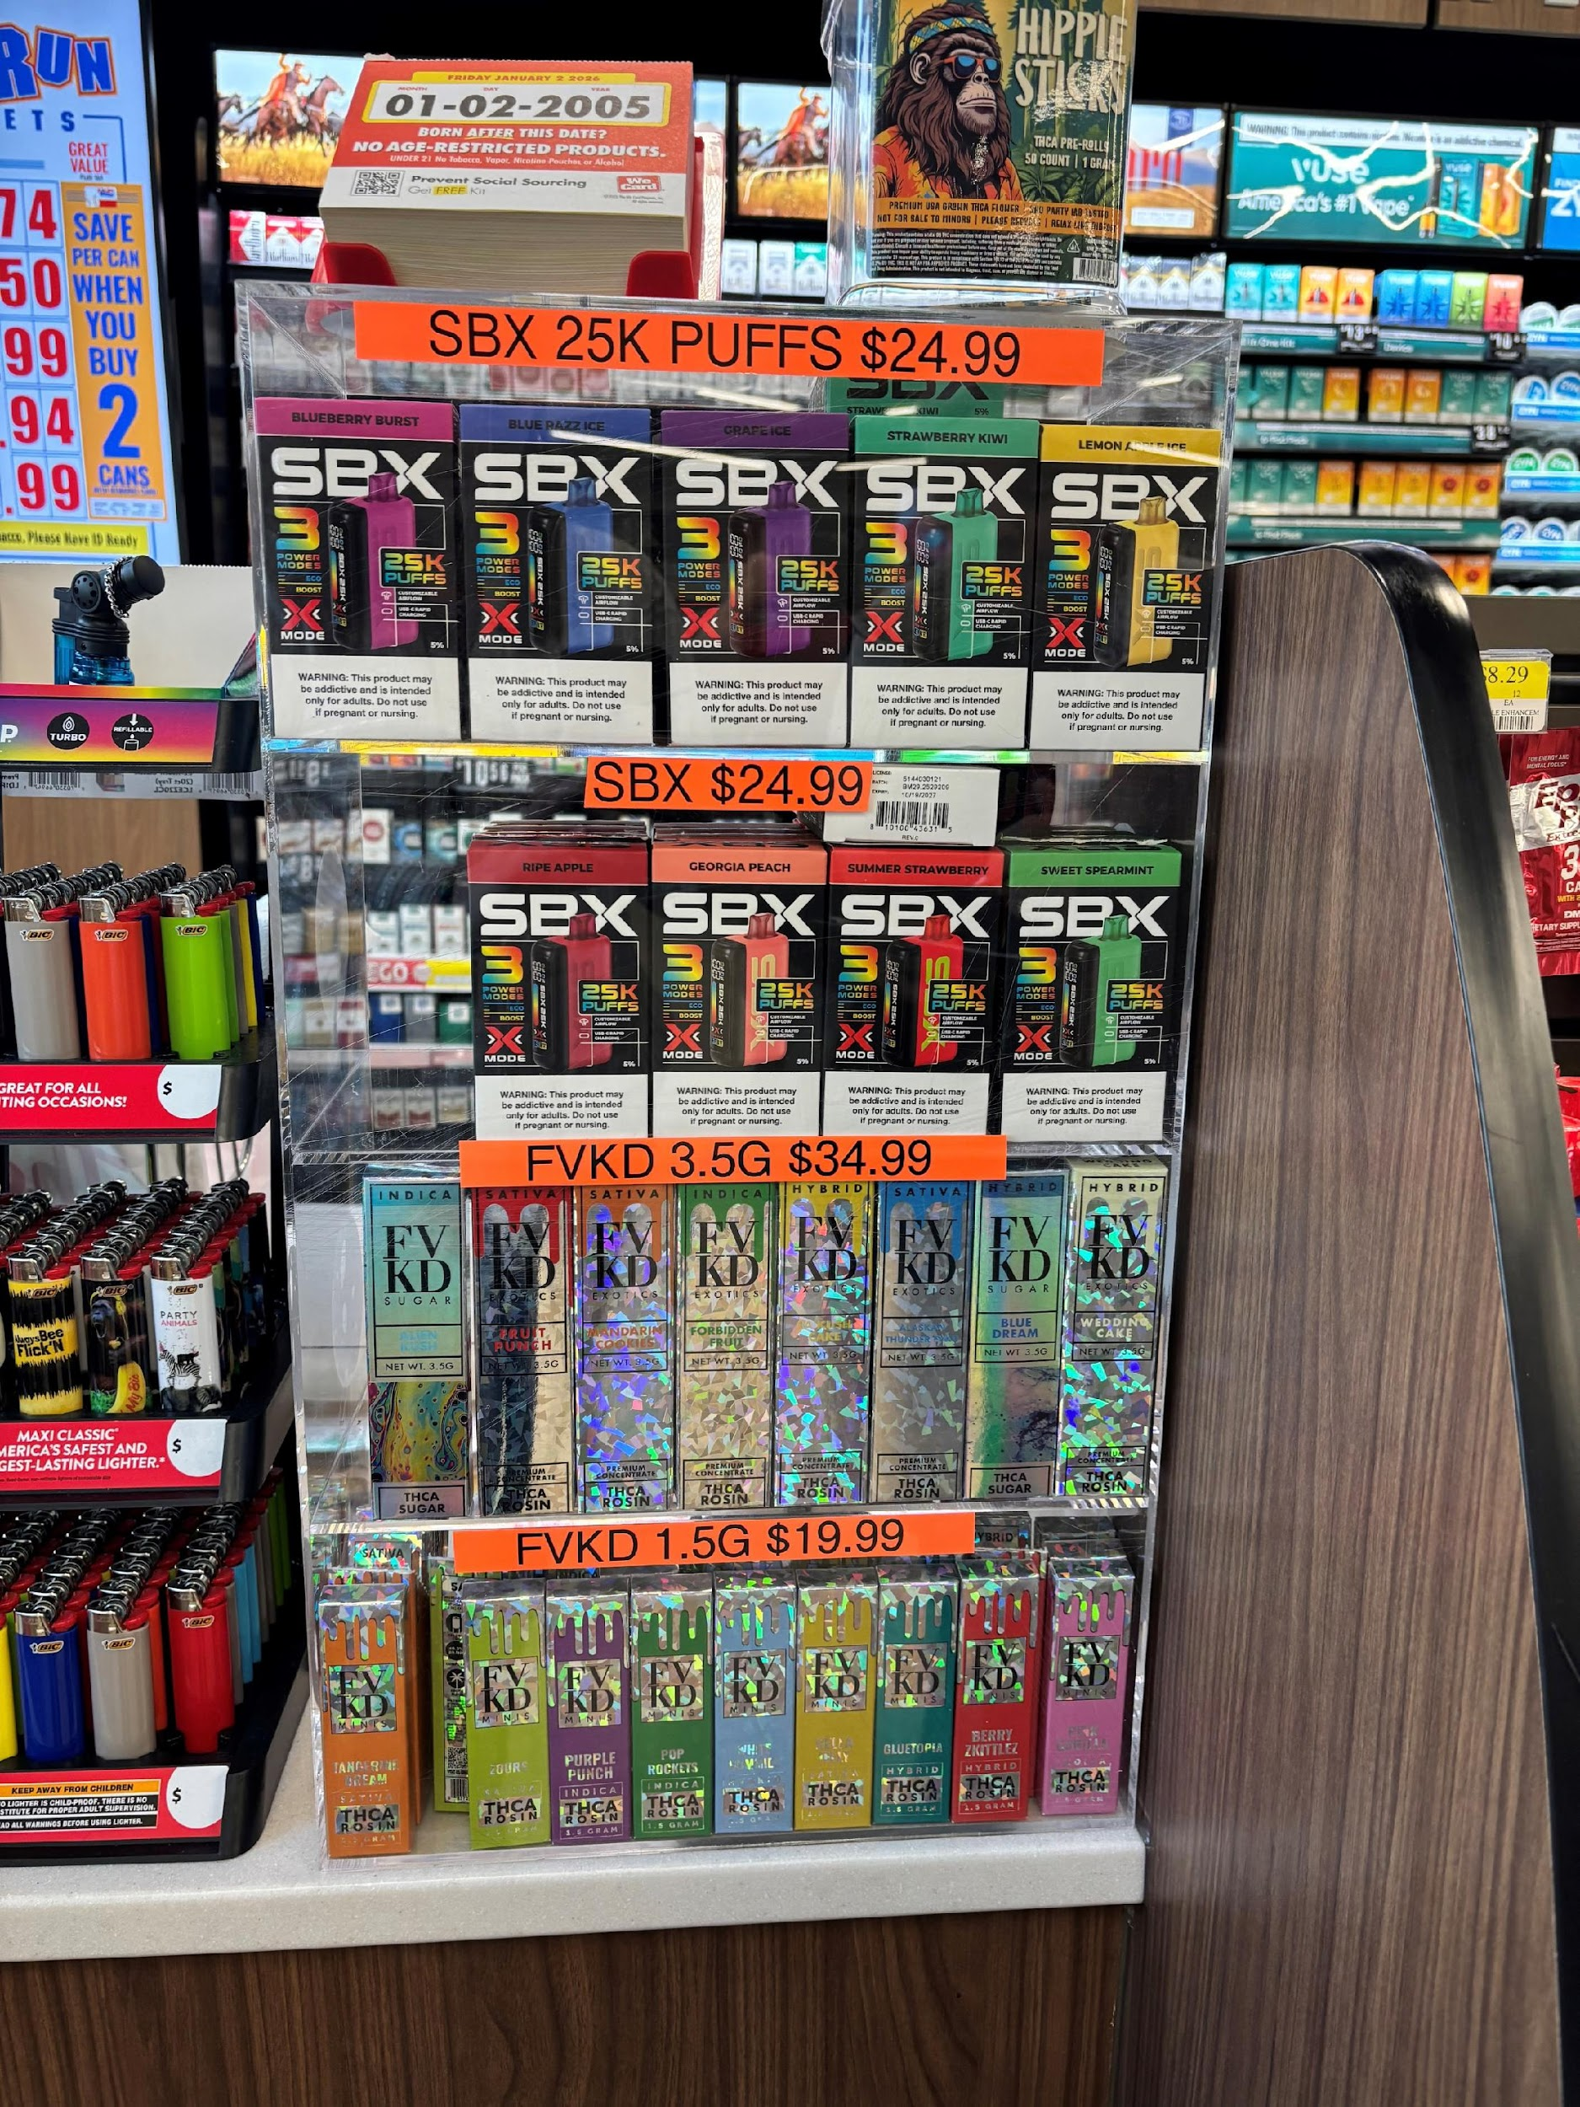



Environmental Scans

Slide 14
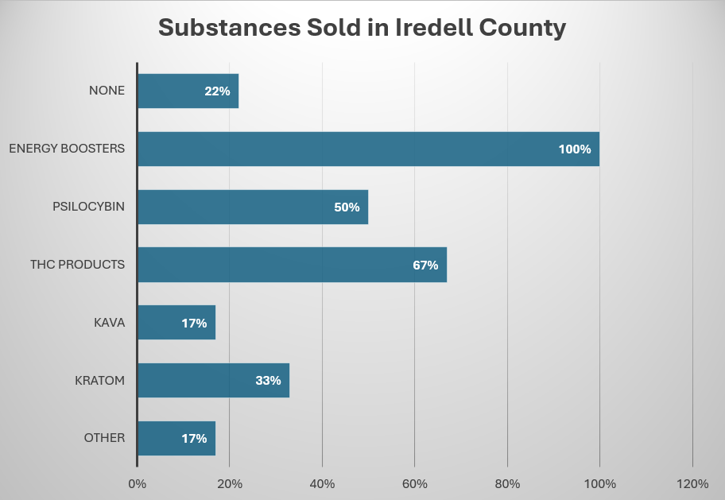

Slide 15



Price
0% Deals and Promotions
  Cheaper when purchased in larger quantities
  2 for 1 specials / buy one get one free

Slide 16
Price
0% Deals and Promotions
  Cheaper when purchased in larger quantities
  2 for 1 specials / buy one get one free

Slide 17
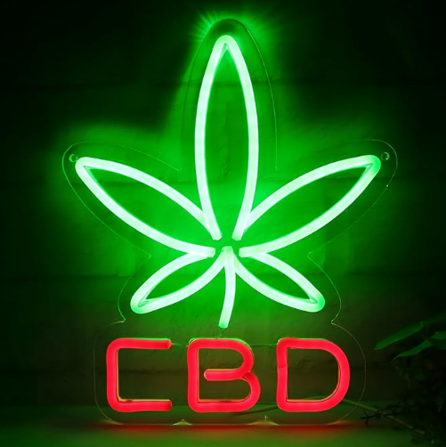
Promotion
17%
Are there any bright colors or characters used to advertise products?
THC Products used bright and glittery colors

Slide 18
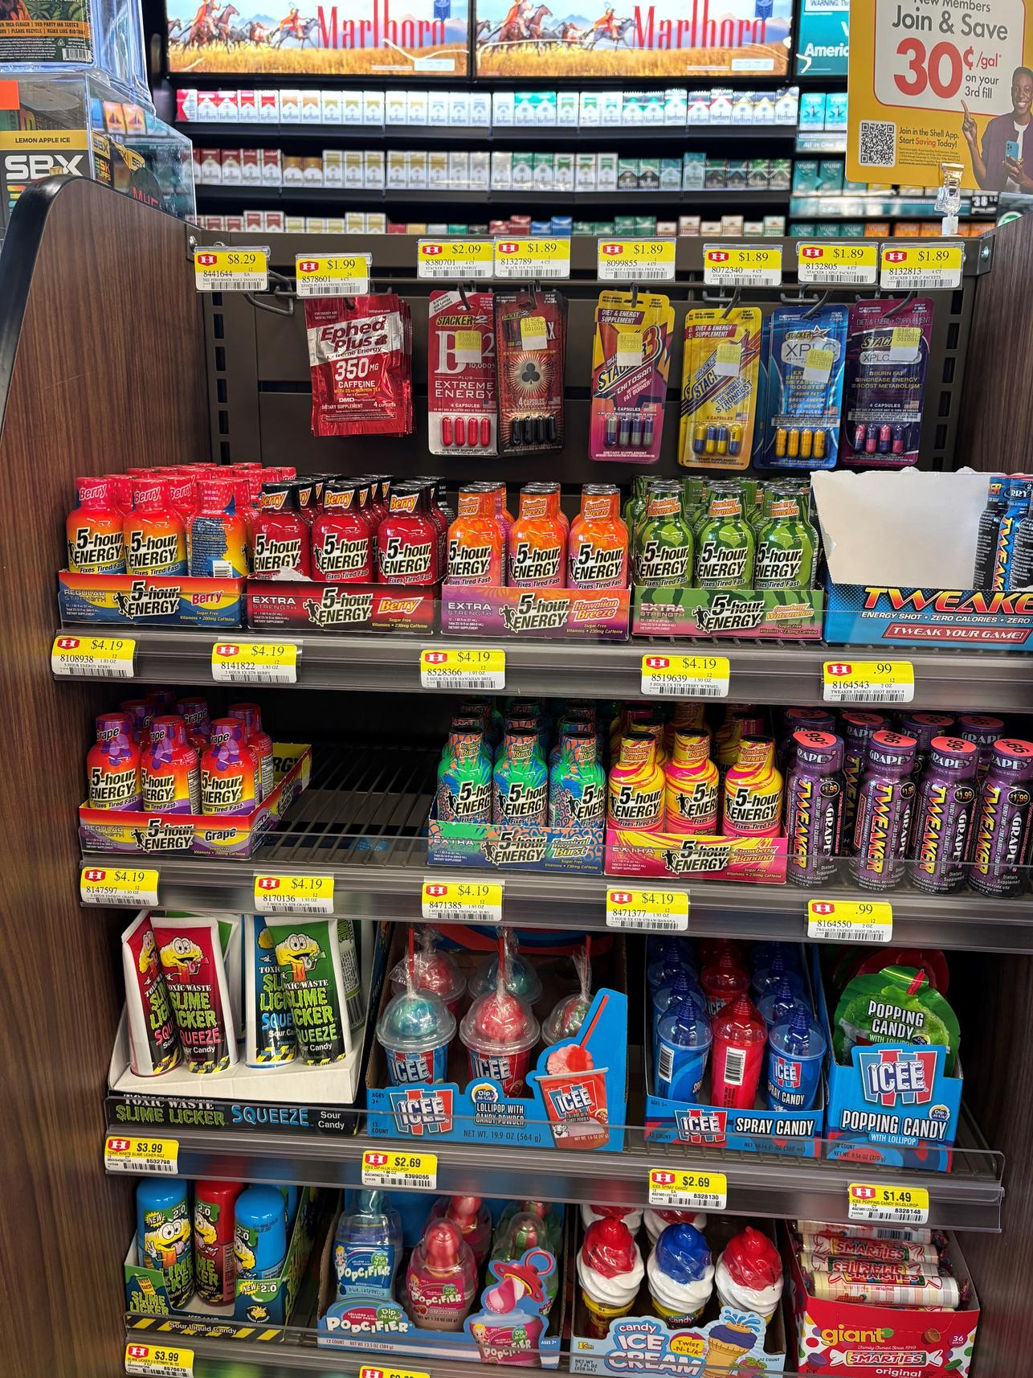

Placement
Are there any products sold next to items children might purchase like candy, chips, or soda?
17%

Slide 19
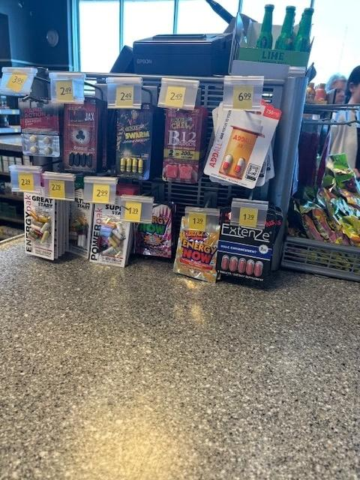

Placement
Are there any products sold at the checkout counter?
100%

Slide 20
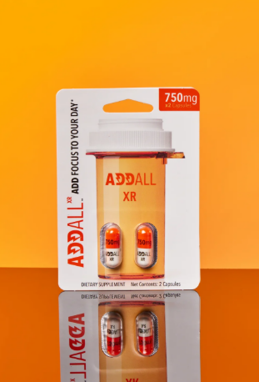
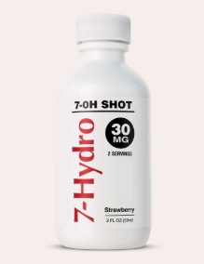
New
Products

Slide 21
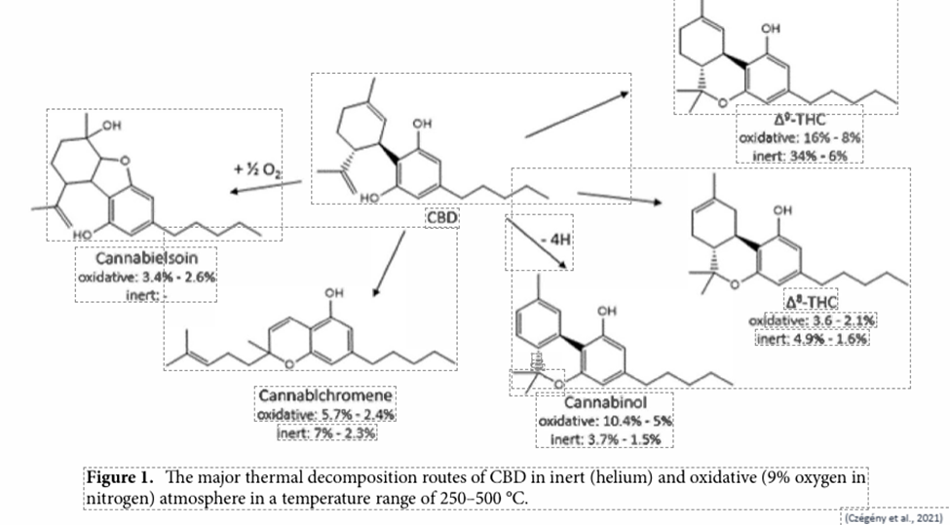
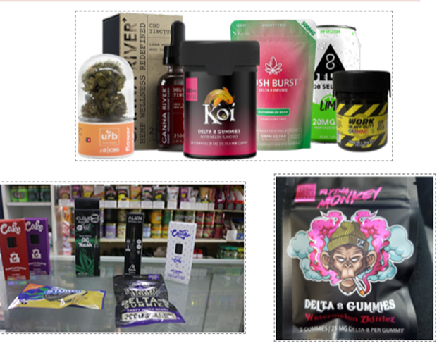
Discuss current state of gas station pharmacology
Semi-Synthetic Cannabinoids (e.g., Delta-8) • Derived from CBD/Hemp
Derived from CBD/Hemp
Variably as psychoactive as Delta-9 THC
Legal in ~39 states
(Czégény et al., 2021)
Notes:
Various psychoactive products, including multiple THC variants and other substances, are easily available online and can be mailed to consumers, often bypassing legal restrictions.
Retailers exploit legal loopholes, offering products such as synthetic cannabinoids, unregulated mushrooms, and kratom.
Many vendors embrace a "gas station pharmacology" model, distributing a range of substances, regardless of regulatory status.
There are inconsistencies and risks associated with the content and labeling of these products

Slide 22
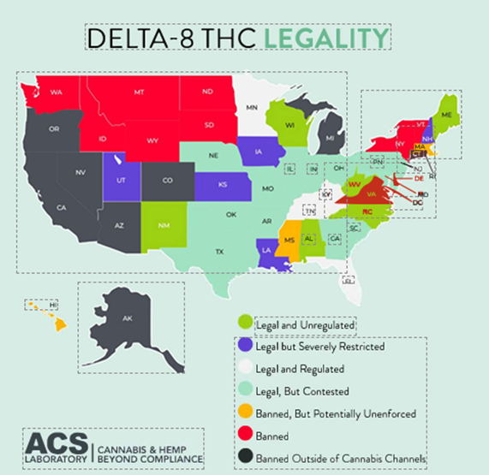
Example of Legality
Notes:
Derived from
CBD/Hemp
50-75% as psychoactive as Delta-9 THC
Legal in ~39 states
Completely unregulated
No health and safety standards
Made using toxic chemicals

Slide 23
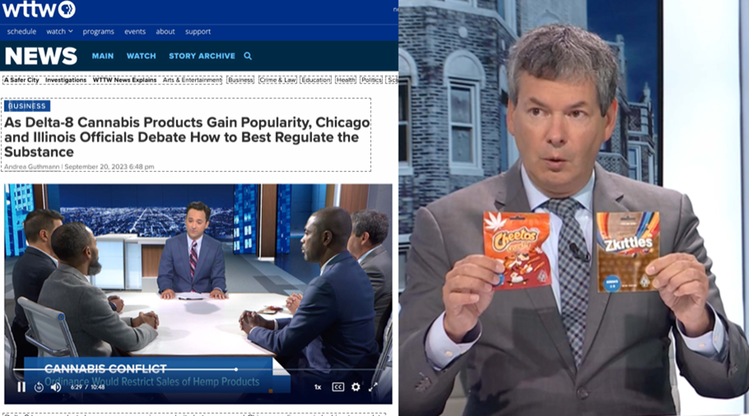
Example of Legality
Notes:
The Farm Bill had an amendment to ban Delta_8 THC: Proponents for Delta products stated it would crush the industry.
You may recall that the bill was extended another year after the November shut-down.

Slide 24
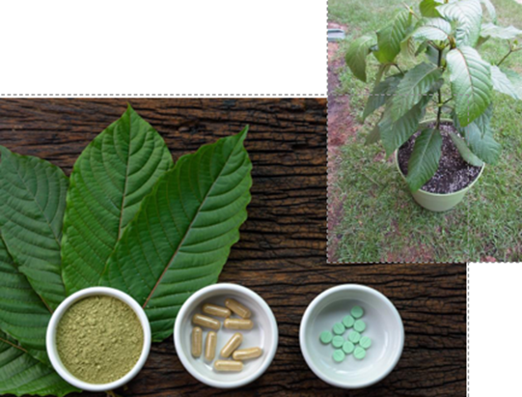
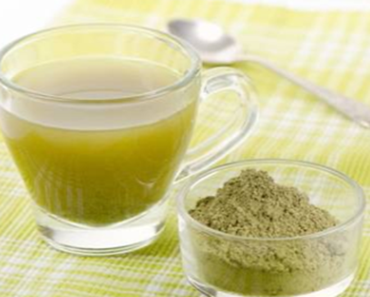
Kratom (7-OH) 13 X More potent than Morphine
(Smith et al., 2023)
Notes:
Leaf-based drug, grows naturally in Malaysia, Thailand, and Indonesia
Currently unregulated
Low doses stimulant effect, high doses opioid effect
(sedative, analgesic)
Also active at serotonin receptors
Brewed in tea
Highly concentrated kratom products, especially those containing 7-OH, can be significantly more potent (up to 13x morphine), raising concerns about overdose and addiction.
Kratom and 7-OH are widely available and aggressively marketed online and in retail outlets, with little regulation or quality control.

Slide 25
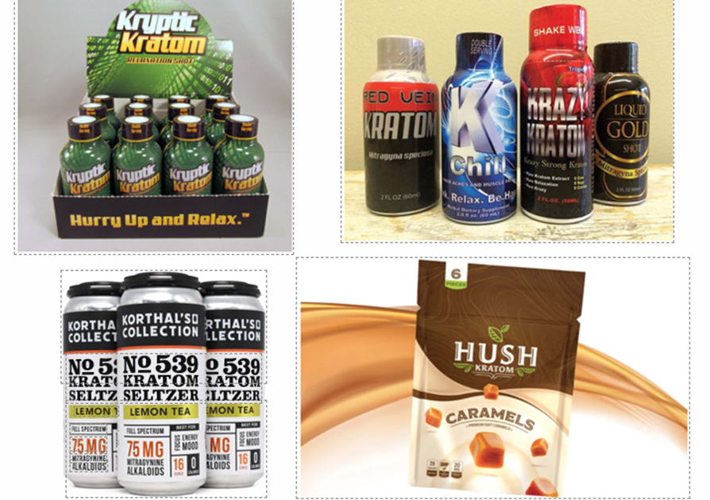
Kratom
*Appeal
“Legal High”
Easily accessible
Easy to use
Stimulant
*Unlike with adults, no association with previous opioid use
May indicate used primarily for euphoric effects
*Association with drug progression not yet known
(Sharma et al., 2022)
(Smith et al., 2023)
Notes:
Capsules
Sprinkled on foods
Mixed into beverages
Not currently regulated
Can be concentrated into a syrup
10x as strong

Slide 26
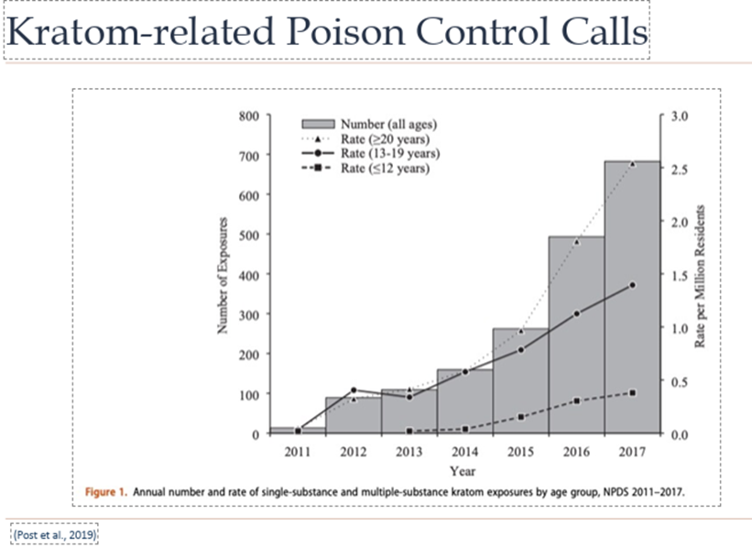
Kratom National Reports
Eggleston et al., 2019) (Post et al., 2019
Notes:
There has been a rise in poison control calls and overdose deaths associated with kratom and its derivatives; mixing with other substances increases risk.
*52.5x increase 2011-2017
13 to 682
Products often contain contaminants like heavy metals (nickel, lead) due to lack of regulation.
Kratom withdrawal is similar to opioids, and its unregulated status raises further health concerns.
*Common complaints
Agitation
Tachycardia
Drowsiness
Vomiting
Confusion
*Severe complaints
Seizure
Withdrawal
Hallucinations
Respiratory depression
Coma
Cardiac or respiratory arrest

Slide 27
Kratom National Reports
152 unintentional overdose deaths involving Kratom from
July 2016 – December 2017
Cause of death in 92
Only substance in system for 7
550 kratom-related deaths in Florida in 2020 and 2021
“99.34% died from drug intoxication, with mitragynine as the specific cause”
(CDC, 2019) (Buresh, 2018) (Botejue et al., 2021) (Suriaga et al., 2023)
Notes:
*Common complaints
Agitation
Tachycardia
Drowsiness
Vomiting
Confusion
*Severe complaints
Seizure
Withdrawal
Hallucinations
Respiratory depression
Coma
Cardiac or respiratory arrest

Slide 28
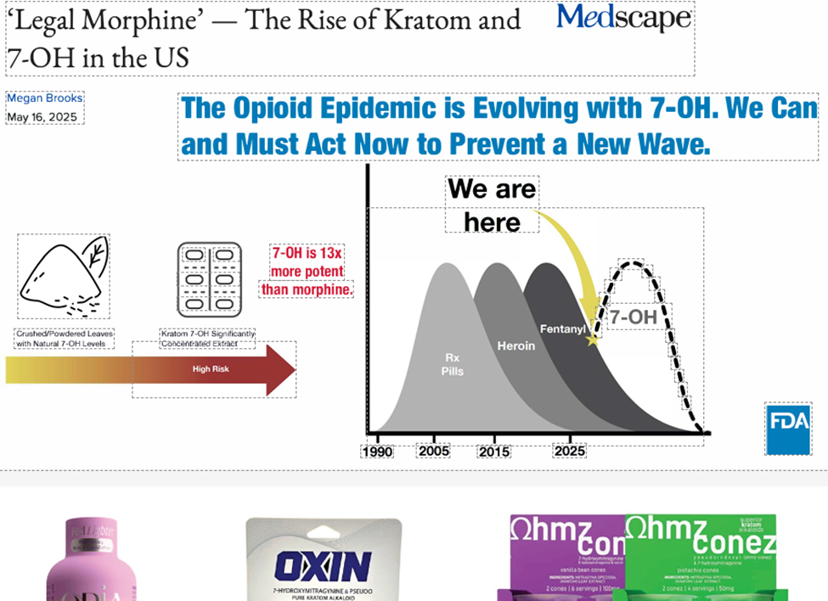
Example of Legality
Notes:
We are in the process of seeing an new wave of an epidemic.
Alaska
Additionally, because of the lack of regulations, there are significant levels of lead and nickel in the kratom according to the FDA. The typical long term user of Kratom will likely develop heavy metal poisoning. They will likely experience nervous system and kidney damage, anemia, high blood pressure, adn increased risk of cancers.

Slide 29
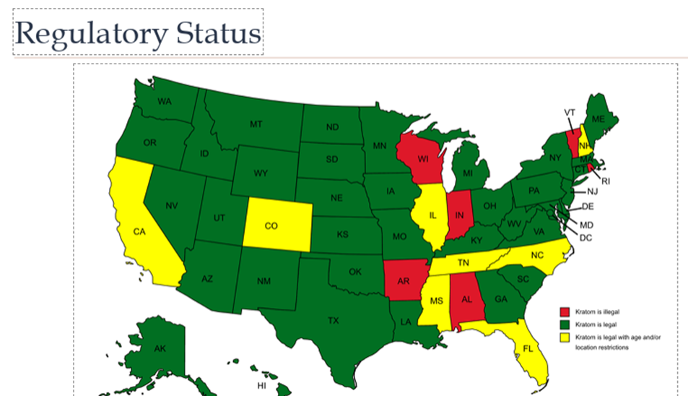

Example of Legality
Notes:
Good news/Bad news
legal but with age and location restrictions
DEA attempted to schedule in 2016, but received pushback from certain lawmakers and an online petition with 100k signatures.
Attempted to continue, but public comment period received 23,000 pro-kratom comments
American Kratom Association (AKA) is very active

Slide 30
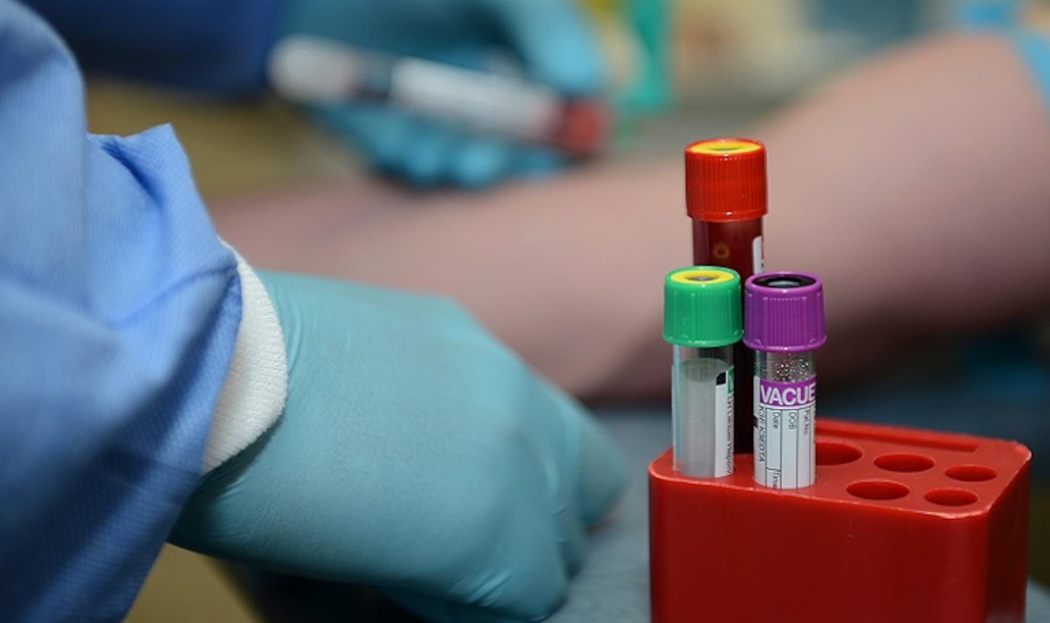
Testing Challenge
Notes:
Standard on-the-spot urine drug tests (enzyme immunoassays) often fail to detect newer or synthetic substances like kratom and tianeptine because they target specific metabolites.
More advanced techniques, such as liquid chromatography mass spectrometry, are required for comprehensive detection but are not routinely used.
The ability to evade detection through standard drug tests contributes to the appeal of these substances for some users.

Slide 31
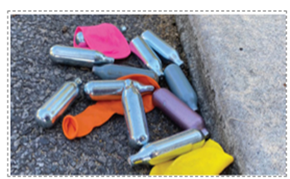
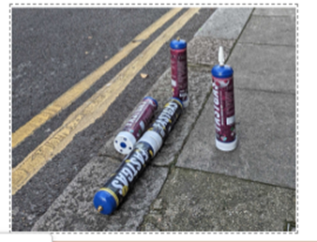
NItrous Oxide
Zaloum, S. A., Mair, D., Paris, A., Smith, L. J., Patyjewicz, M., Onen, B. L., & Noyce, A. J. (2025). Tackling the growing burden of nitrous oxide-induced public health harms. The Lancet Public Health, 10(3), e257-e263.
Notes:
Easily available, application for whipped cream
Broad mechanism of action
Blocks NMDA receptors
Painkiller
Activates GABA system
Anti-anxiety
Stimulates CNS
Raises energy, supports cardiac function, increases blood flow to the brain

Slide 32
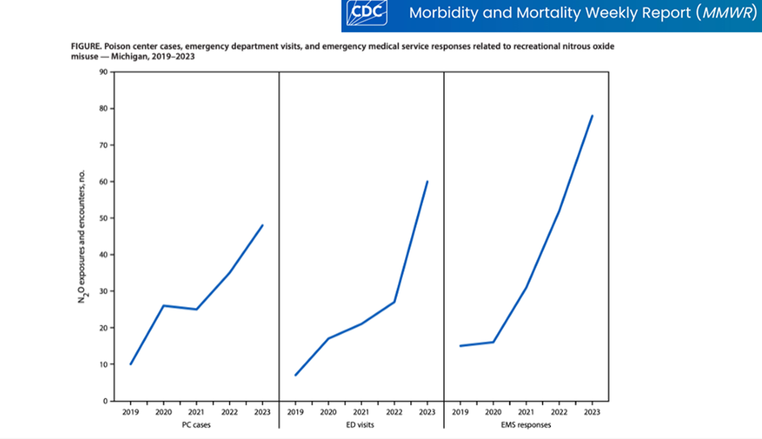
NItrous Oxide
Vohra, V. (2025). Notes from the field: recreational nitrous oxide misuse—Michigan, 2019–2023. MMWR. Morbidity and Mortality Weekly Report, 74.
Notes:
Adverse health effects
Risk of brain damage and death
Heart attack, nerve damage
Memory loss, depression, muscle spasms
If used directly from containers can cause frostbite or rupture lung tissue
Adverse health effects
Risk of brain damage and death
Heart attack, nerve damage
Memory loss, depression, muscle spasms
If used directly from containers can cause frostbite or rupture lung tissue

Slide 33
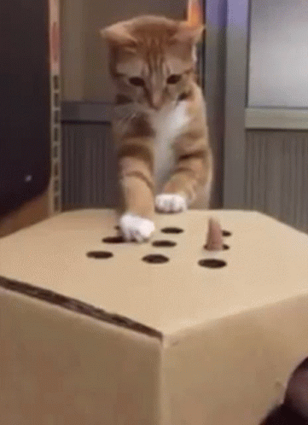
Tianeptine
Notes:
House Bill 250, 2024, added Tianeptine to Schedule II of Controlled Substances Act allowing for criminal penalties for unlawful manufacturing, sale, distribution or possession of it.
tianeptine ("gas station heroin"), mad honey, kava, and Robitussin are also discussed as accessible but largely unregulated intoxicants, each with unique risks and minimal detection on drug tests.

Slide 34
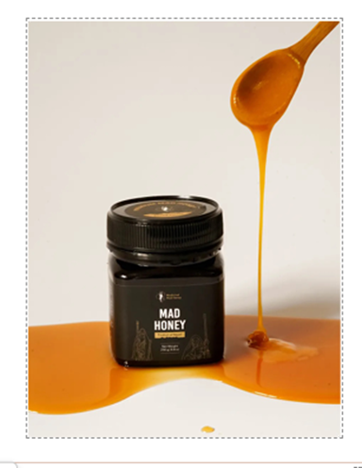
Mad Honey
Bubnova, A. M., & Galchenko, A. V. (2024). Natural Aphrodisiacs: Traditional use, mechanism of action, clinical efficacy, and safety. The Natural Products Journal, 14(1), 2-17.
Notes:
Grayanotoxin-infused honey
Turkey and Nepal
Holds open sodium channels in nerve, skeletal, and cardiac muscle cells causing electrical disfunction and “mad honey poisoning”
Hallucinations, euphoria
Adverse Effects
Slow heart rate, lower blood pressure, heart rhythm disorders
Dizziness, agitation, weakness, fainting

Slide 35

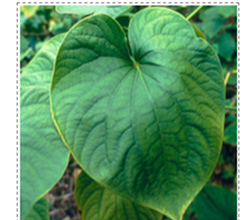
Kava
Bubnova, A. M., & Galchenko, A. V. (2024). Natural Aphrodisiacs: Traditional use, mechanism of action, clinical efficacy, and safety. The Natural Products Journal, 14(1), 2-17.
Notes:
Grayanotoxin-infused honey
Turkey and Nepal
Holds open sodium channels in nerve, skeletal, and cardiac muscle cells causing electrical disfunction and “mad honey poisoning”
Hallucinations, euphoria
Adverse Effects
Slow heart rate, lower blood pressure, heart rhythm disorders
Dizziness, agitation, weakness, fainting

Slide 36
Risk Education and Informed Decision-Making
Notes:
Emphasis is placed on educating individuals about understanding risk rather than simply telling them what substances to avoid.
The importance of helping people make informed decisions aligned with their values is discussed, especially since new substances and formulations continuously emerge.
Legal availability does not equate to safety; consumers need to be aware of unknowns related to content, potency, and health impacts.

Slide 37
What has DACI done?
Document your findings using photos and environmental scan documents
Share during a coalition meeting
Write a press release for your local paper
Host a legislative breakfast or Town Hall meeting
Create heat maps to show correlations between areas that children frequent and/or areas of high crime/violence
Follow up with the businesses you visited

Slide 38
Action Items
*Share information
*Request more information
*Encourage lab testing
*Communicate with HR and recovery organizations
*Collaborate with owners of stores
*Monitor ongoing legislative changes and encourage local legislators of the need for regulation of substances
Notes:
Share information with parents and teachers to educate them of the dangers associated with gas station pharmacology
*Request more information about research of current products
*Encourage healthcare and MEs to confirm lab testing for clients suspected of using unregulated substances
* Communicate with HR and recovery organizations about the possibility of dependance potential and dangers of available substances
*. Monitor ongoing legislative changes and encourage local legislators of the need for regulation of substances
* Request that owners of stores help monitor products and share dangers with owners

Slide 39
Questions?
@impactcarolina

Slide 40



Kelly V. Teague
kelly@impactcarolina.org
Facebook
Community Impact NC
Twitter
@impactcarolina
Instagram
communityimpact_nc
Presenter Name

Slide 41


Thank You
@impactcarolina

Slide 42
References
Botejue, M., Walia, G., Shahin, O., Sharma, J., Zackria, R., & Sharma, J. S. (2021). Kratom-induced liver injury: a case series and clinical implications. Cureus, 13(4).
Suriaga, A. A., Tappen, R. M., McCurdy, C. R., Newman, D., Grundmann, O., & Kelly, J. F. (2025). The Associations of Kratom (Mitragynine), Opioids, Other Substances, and Sociodemographic Variables to Drug Intoxication–related Mortality. Journal of Addiction Medicine, 19(3), 306-313.
Henningfield, J. E., Grundmann, O., Huestis, M. A., & Smith, K. E. (2024). Kratom safety and toxicology in the public health context: research needs to better inform regulation. Frontiers in Pharmacology, 15, 1403140.
Bubnova, A. M., & Galchenko, A. V. (2024). Natural Aphrodisiacs: Traditional use, mechanism of action, clinical efficacy, and safety. The Natural Products Journal, 14(1), 2-17.
Buresh, M. (2018). Treatment of kratom dependence with buprenorphine-naloxone maintenance. Journal of addiction medicine, 12(6), 481-483.
Vohra, V. (2025). Notes from the field: recreational nitrous oxide misuse—Michigan, 2019–2023. MMWR. Morbidity and Mortality Weekly Report, 74.
Post, S., Spiller, H. A., Chounthirath, T., & Smith, G. A. (2019). Kratom exposures reported to United States poison control centers: 2011–2017. Clinical toxicology, 57(10), 847-854.
Czégény, Z., Nagy, G., Babinszki, B., Bajtel, Á., Sebestyén, Z., Kiss, T., ... & Csupor, D. (2021). CBD, a precursor of THC in e-cigarettes. Scientific Reports, 11(1), 8951.
Zaloum, S. A., Mair, D., Paris, A., Smith, L. J., Patyjewicz, M., Onen, B. L., & Noyce, A. J. (2025). Tackling the growing burden of nitrous oxide-induced public health harms. The Lancet Public Health, 10(3), e257-e263.
Sharma, V., Cottler, L. B., Bares, C. B., & Lopez-Quintero, C. (2022). Kratom use among US adolescents: analyses of the 2019 National Survey on Drug Use and Health. Journal of Adolescent Health, 70(4), 677-681.
Eggleston, W., Stoppacher, R., Suen, K., Marraffa, J. M., & Nelson, L. S. (2019). Kratom use and toxicities in the United States. Pharmacotherapy: The Journal of Human Pharmacology and Drug Therapy, 39(7), 775-777.
https://www.shrm.org/topics-tools/tools/hr-answers/basics-
environmental-scanning-part-strategic-planning-process

Slide 43
Extra Resources
@impactcarolina

Slide 44
Considerations for Follow-Up
Focus Area | On-Premise | Off-Premise
Primary Concern | Over-service & impaired driving | Underage sales & youth access
Key Risk Factors | Drink specials, lack of RBS training, inadequate ID checks | Inconsistent ID checks, product placement, advertising near youth items
Tone of Follow-up | Partnership around responsible service & liability reduction | Compliance support & youth access prevention
Recommended Resources | Responsible Beverage Service (RBS) training, house policy templates | ID guides, Tobacco 21 signage, clerk refusal training materials
Policy Improvement Strategies | Written alcohol service policies, staff training refreshers | Clear ID-check policy, product placement adjustments, reduced exterior advertising
Recognition Opportunities | “Responsible Service Partner” certificates or social media recognition | “Youth Access Prevention Partner” recognition or window decals
Long-term Engagement | Invite managers to coalition discussions on impaired driving prevention | Invite store owners to prevention initiatives & retail roundtables

