Slide 1
No Wrong Door: Meeting the Needs of Individuals with Mental Health and Substance Use Disorders.
Molly Richardson LCSW, LCAS, CCS
Mollyr@theblanchardinstitute.com
828-337-8202

Slide 2
Objectives:
Understand how individuals living with mental health and substance use disorders often experience complex, overlapping challenges that require thoughtful, integrated care.
Understand the prevalence of mental health, substance abuse and co-occurring disorders and the historical and current barriers that have limited access to effective treatment.
Participants will gain a deeper understanding of symptom severity across a continuum and how accurate assessment informs appropriate treatment planning.
Explore and understand how evidence-based approaches work in real-world settings and emphasize the importance of meeting individuals where they are by tailoring treatment to support meaningful, sustainable recovery outcomes.

Slide 3
Mental Disorder
A mental disorder is a syndrome characterized by clinically significant disturbance in an individual’s cognition, emotion regulation, or behavior that reflects dysfunction in psychological, biological, or developmental processes underlying mental functioning.

Slide 4
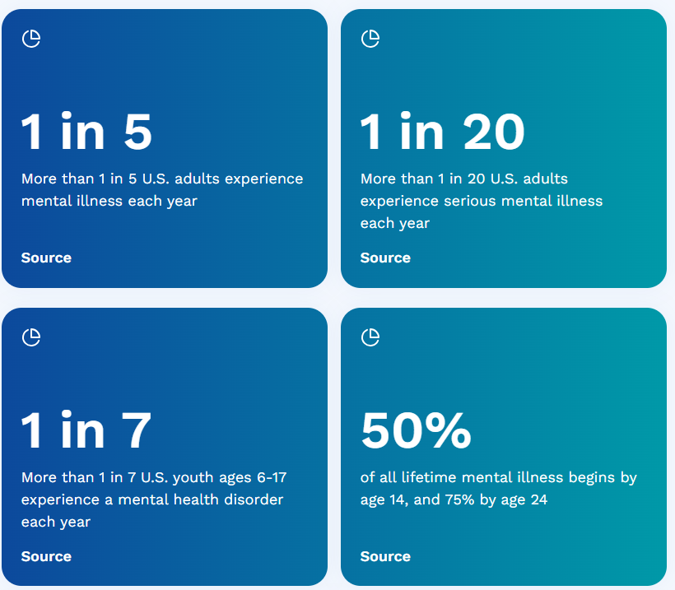
https://www.nami.org/mental-health-by-the-numbers/

Slide 5

Definitions
Any mental illness (AMI) is defined as a mental, behavioral, or emotional disorder. AMI can vary in impact, ranging from no impairment to mild, moderate, and even severe impairment (e.g., individuals with serious mental illness as defined below).
Serious mental illness (SMI) is defined as a mental, behavioral, or emotional disorder resulting in serious functional impairment, which substantially interferes with or limits one or more major life activities. The burden of mental illnesses is particularly concentrated among those who experience disability due to SMI.
National Institute of Mental Health

Slide 6
Substance Use Disorder (SUD)
Substance Use Disorder is a problematic pattern of substance use leading to clinically significant impairment or distress.
Manifested by at least two of 11 criteria:

Slide 7
Substance Abuse Statistics
Among Americans aged 12 years and older, 47.7 million were current illegal drug users (used within the last 30 days) as of 2023.
16.8% of Americans 12 and over used drugs in the last month, a 1.9% increase year-over-year (YoY).
70.5 million or 24.9% of people 12 and over have used illegal drugs or misused prescription drugs within the last year.
145.1 million people aged 12 and over have illicitly used drugs in their lifetime.
1.15 million- Drug overdoses have killed over 1 million people in the U.S. alone since 1999.
134.7 million Americans 12 and have consumed alcohol in the past month.
28.9 million or 21.5% of Americans who have consumed alcohol in the past month have an alcohol use disorder.
64.4 million people have used tobacco or nicotine vaping products within the past month.
38.6% of illegal drug users have a drug disorder.
21.6% of those with drug disorders have an opioid disorder; this includes prescription pain relievers or “painkillers” and heroin).

Slide 8
North Carolina’s Behavioral Health Regulatory Structure (Subchapter 27G)
North Carolina regulates services for three populations:
  Mental Illness (MI)
  Developmental Disabilities (IDD)
  Substance Use Disorders (SUD)

Slide 9
In general terms:
Mental illness is defined as a condition involving disturbance of thought, mood, or behavior that impairs functioning and requires treatment.
How North Carolina Defines Substance Abuse / Substance Use Disorder
Conditions based on maladaptive patterns of psychoactive substance use that continue despite harmful consequences.
  The rules describe:
    Alcohol abuse- means psychoactive substance abuse which is a residual category for noting maladaptive patterns of psychoactive substance use that have never met the criteria for dependence for that particular class of substance and which continues despite adverse consequences. The criteria for alcohol abuse delineated in the DSM IV is incorporated by reference.
    "Alcohol dependence" means psychoactive substance dependence which is a cluster of cognitive behavioral, and physiologic symptoms that indicate that a person has impaired control of psychoactive substance use and continues use of the substance despite adverse consequences. The criteria for alcohol dependence delineated in the DSM IV is incorporated by reference
    "Drug abuse" means psychoactive substance abuse which is a residual category for noting maladaptive patterns of psychoactive substance use that have never met the criteria for dependence for that particular class of substance which continues despite adverse consequences. The criteria for drug abuse delineated in the DSM IV is incorporated by reference.
    "Drug dependence" means psychoactive substance dependence which is a cluster of cognitive behavioral, and physiologic symptoms that indicate that a person has impaired control of psychoactive substance use and continues use of the substance despite adverse consequences. The criteria for drug dependence delineated in the DSM IV is incorporated by reference.

Slide 10
Similarities Between Mental Health Disorders and Substance Use Disorders
Both Are Diagnosable Clinical Conditions
Both conditions are defined as clinically significant syndromes that involve:
Disturbances in behavior, cognition, or emotional regulation
Clinically significant distress or impairment in functioning
Both must meet specific diagnostic criteria in the DSM-5-TR.
Involve Brain-based impairment
Have multifactorial causes
That cause functional impairment

Slide 11
Diagnostic Criteria
Mental health disorders are usually diagnosed based on:
Symptom clusters
Duration
Severity
Functional impairment
Substance Use Disorders are diagnosed using behavioral criteria related to substance use, including:
Loss of control over use
Tolerance
Withdrawal
Craving
Continued use despite harm

Slide 12
Defining Distinction…
Mental health disorders:
Do not require substance involvement
Substance use disorders:
Require repeated use of a specific substance

Slide 13
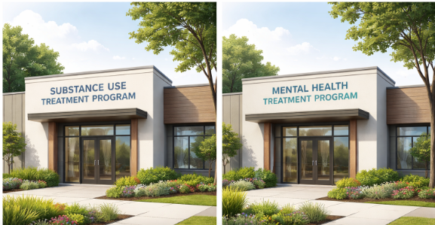

Slide 14
What if a persons has both mental health and substance use disorders?
A large portion of individuals experience both simultaneously, called co-occurring disorders.
Many individuals self-medicate mental health symptoms with substances
Notes:
Sometimes people have both… mental health and SUD.

Slide 15

MH and SUD symptoms amplify each other
Substance use may:
Worsen depression, anxiety, psychosis, or trauma symptoms
Interfere with psychiatric medications
Create cycles of relapse
Mental health issues may:
Increase self-medicating behaviors
Create more isolating and alimentation from supports
Impact motivation and judgment

Slide 16
Suicide / Self-Harm
In 2023- Suicide was the eleventh leading cause of death overall in the United States, claiming the lives of over 49,300 people.
90% of people who die by suicide may have experienced symptoms of a mental health disorder, according to interviews with family, friends and medical professionals (also known as psychological autopsy) Mental Health By the Numbers | NAMI
Substance use impairs judgment and increases impulsivity, raising the risk of suicide attempts and death.
  Risk of death by suicide increases
    5.8 times for people with alcohol use disorder (AUD),
    8.1 times for people with alcohol and drug use disorders
    11.2 times for people with alcohol, drug, and tobacco use disorders.
    Substance Use Disorder Increases Risk of Suicidal Thoughts and Attempts | The Pew Charitable Trusts
In 2023, nearly 1,600 suicides were recorded in North Carolina, according to NCDHHS. NC DHHS

Slide 17
Adult Drug Abuse & Mental Health
In 2023, 20.4 million or 7.9% of all adults aged 18 and older in the US had both AMI and at least one SUD in the past year.
6.8 million, or 2.6% of all adults in the US, had a co-occurring SMI and SUD in the past year.
26.7% of adults with AMI and 29.4% of adults with SMI were binge drinkers.
51.9% of adults with SMI 42.4% of adults with AMI used illegal drugs in 2023.
Among adults with AMI and SUD, around 62.4% received either mental health care or specialty substance abuse treatment
37.6% of adults with AMD and SUD received no care.
https://drugabusestatistics.org/

Slide 18

This is why integrated treatment is now the standard of care.

Slide 19

How do we do this?

Slide 20
Starting at the beginning-
Comprehensive Diagnostic Assessment
Gather a multidimensional understanding of the individual’s mental health, substance use, medical, and psychosocial functioning to guide treatment planning.
Presenting Concerns
  Ask the client why they are seeking services now.
  Explore what they hope will be different after treatment.
  Note: The individual may not know exactly what they need — allow open-ended responses.
Risk Assessment
  Assess risk in both mental health and substance use domains:
    Suicidal or self-harm risk
    Risk of harm to others
    Overdose or severe withdrawal risk
    Impulsivity or dangerous behaviors
Mental Health Assessment
  Symptoms: type, severity, frequency
  Age of onset / course of symptoms
  Functional impairment: social, occupational, educational
  Previous diagnoses and treatment history
  Medications and response
Substance Use Assessment
  Type(s) of substances (alcohol, drugs, prescription misuse)
  Frequency, quantity, route, duration
  Age of first use and patterns over time
  Functional impact (legal, social, work, health)
  Withdrawal or cravings
  Previous treatment history
Medical / Physical Health Assessment
  Chronic illnesses and current medications
  Allergies
  Past hospitalizations or surgeries
  Sleep, nutrition, and exercise habits

Slide 21
ASAM and LOCUS
 | Strengths | Weaknesses
ASAM | Provides a comprehensive multidimensional assessment Standardizes Level of Care based on the 6 dimensions Includes mental health Supported by insurance companies | Substance use focused (Mental health is considered in relation to how it impacts substance use, not as a primary condition) Less precise for complex mental health needs
LOCUS | - Primarily designed for mental health treatment, especially for serious and persistent mental illness - Standardizes Level of Care based on 6 levels | Less emphasis on substance use. May underrepresent SUD needs especially related to withdrawal, craving or relapse potential

Slide 22
Clinical Decision Tree
Step 1: Initial Assessment
Conduct a Comprehensive Diagnostic Assessment and use evidenced based tools
- MH: LOCUS, PHQ-9, GAD-7, MINI, C-SSRS
- SUD: ASAM, AUDIT, DAST-10, CAGE-AID, ASI
        - Co-Occurring- Global Appraisal of Individual need (GAIN), Addiction Severity Index (ASI), CAAPE
Document current functioning, safety concerns, and recent crisis.
Step 2: Assess Mental Health (MH) Symptoms
Determine Symptom Severity
Low MH Risk | High MH Risk
Minimal functional impairment Mild anxiety, mild depression No acute safety concerns | Significant functional impairment Severe depression, psychosis, mania, suicidal ideation Acute safety concerns (self-harm, aggression)
Determine Symptom Severity
Low SUD Risk | High SUD Risk
Occasional use No functional impairment No psychological dependence | Frequent or daily use Functional impairment (work, social, health) Withdrawal, tolerance, craving Significant risk for accidental overdose

Slide 23
Quadrant 2
Quadrant 3
Quadrant 4
Low

Slide 24
Quadrant Descriptions
Quadrant 1
High MH Risk
High SUD Risk
Significant co-occurring needs
Likely appropriate for PHP, residential SUD + MH, Hospitalization
Quadrant 2
Low MH Risk
High SUD Risk
Primarily substance-focused needs
May be appropriate for residential, SUD PHP, SUD IOP, outpatient counseling, or medication-assisted treatment
Quadrant 3
Low MH Risk
Low SUD Risk
Mild or early-stage concerns
Likely best suited for outpatient therapy, brief intervention, or community resources
Quadrant 4
High MH Risk
Low SUD Risk
Significant mental health needs with minimal substance involvement
Often appropriate for PHP, MH IOP, or psychiatric hospitalization evaluation and stabilization
Intensive stabilization recommended

Slide 25
Conceptual Placement on the Grid
Quadrant 1
High MH Risk / High SUD Risk
Most appropriate:
Harm Reduction + Structured Abstinence Supports
Why:
Clients are often not ready or able to immediately stop substances.
Engagement, safety, medication support, and stabilization come first.
Full abstinence may be a long-term goal, not an immediate requirement.
Example graph position: Harm reduction-heavy, with abstinence as a secondary goal.
Quadrant 2
Low MH Risk / High SUD Risk
Most appropriate:
Abstinence-Based or Abstinence-Focused Treatment
Why:
Primary issues are substance-related.
Clients may benefit from structured abstinence expectations (PHP, IOP, MAT, etc.).
Motivational readiness more easily targeted.
Example graph position: Most abstinence-oriented area on the chart.
Quadrant 3
Low MH Risk / Low SUD Risk
Most appropriate:
Light Harm Reduction or Preventive Coaching
Why:
Early-stage use or experimental use.
Education and moderation strategies are often enough.
Abstinence may not be necessary unless goals indicate otherwise.
Example graph position: Mild harm reduction zone.
Quadrant 4
High MH Risk / Low SUD Risk
Most appropriate:
Mental-Health-Driven Approach + Harm Reduction for Safety
Why:
Substance use isn’t the primary problem.
Harm reduction (e.g., medication monitoring, safety planning) supports MH stabilization.
Abstinence is usually unnecessary unless clinically indicated.
Example graph position: Harm-reduction supportive but low SUD involvement.

Slide 26
Admission- How we Determine Placement
Client preference is considered but does not determine level of care.
Final placement is based on clinical discretion, assessment data, and diagnosis.
Primary diagnosis guides initial program assignment.
If co-occurring conditions are unclear at intake, clients may be reassigned as we learn more.
We aim to remove barriers—movement between programs is flexible and
clinically driven.

Slide 27
Treatment planning
Treatment planning begins with the knowledge that mental health and substance use interact and amplify each other.
Ask the question- What does this person need right now to stabilize and begin recovery?
Develop a plan and support for safety
Engage family and social supports immediately
Identify and leverage strengths/offer hope
Ensure the plan include whole person needs, but prioritize
Engage evidence-based modalities

Slide 28
Mental Health Only
Curriculum | Target Population | Core Components | Evidence
CBT for Anxiety & Depression | Adults with depression, anxiety | Cognitive restructuring, behavioral activation, problem-solving | Multiple RCTs support effectiveness for depression & anxiety
Dialectical Behavior Therapy (DBT) Skills Training | Clients with emotion dysregulation, self-harm behaviors | Mindfulness, distress tolerance, emotion regulation, interpersonal effectiveness | Strong evidence for borderline personality disorder & emotion regulation
Trauma-Focused CBT (TF-CBT) | Clients with PTSD, trauma history | Psychoeducation, trauma narrative, coping skills | Evidence-based for children/adolescents; adapted for adults
Acceptance and Commitment Therapy (ACT) | Adults with mood disorders, anxiety, stress | Mindfulness, values-based action, acceptance | RCTs support symptom reduction
WRAP (Wellness Recovery Action Plan) | Severe mental illness, chronic psychiatric disorders | Self-management, wellness planning, early warning signs | Peer-reviewed evidence for recovery-oriented outcomes

Slide 29
Substance Use Only
Curriculum | Target Population | Core Components | Evidence
Matrix Model | Stimulant users, mixed SUD populations | CBT, relapse prevention, family education, 12-step support | NIDA-supported, effective for stimulant users
Seeking Safety | Clients with SUD and trauma (can be used SUD only) | Coping skills, psychoeducation, safe behaviors | Supported for PTSD + SUD, also for SUD-only relapse prevention
Motivational Enhancement Therapy (MET) | Any SUD | Motivational interviewing techniques, goal-setting | Strong evidence for engagement and reduced use
12-Step Facilitation (TSF) | Alcohol and drug users | Engagement with AA/NA principles, abstinence support | SAMHSA and NIAAA supported for alcohol use disorder
Relapse Prevention CBT (Marlatt & Gordon model) | Adults with any SUD | Identifying triggers, coping strategies, problem-solving | Broad evidence base

Slide 30
Co-Occurring Disorders
Curriculum | Target Population | Core Components | Evidence
Integrated Dual Disorder Treatment (IDDT) | Adults with serious mental illness + SUD | Integrated team approach, psychoeducation, CBT, medication management | SAMHSA-endorsed; RCTs show improved retention and outcomes
Seeking Safety | Adults with PTSD + SUD or other MH disorders | Coping skills, psychoeducation, safety planning | Highly effective for trauma + SUD; adaptable for other MH
Double Trouble in Recovery (DTR) | Adults with SMI + SUD | Psychoeducation on psychiatric symptoms & SUD, relapse prevention, mutual support | Evidence supports reduction in psychiatric symptoms and substance use
CBT for Co-Occurring Disorders | Adults with depression, anxiety + SUD | Cognitive restructuring, coping, relapse prevention | Meta-analyses show effectiveness for dual symptoms
Motivational Interviewing (MI) | Co-occurring MH + SUD | Enhancing motivation for treatment, reducing ambivalence | Evidence for engagement and retention

Slide 31
Multidisciplinary Team & Staffing
Build a team with diverse expertise to deliver holistic care.
Key Elements:
  Provisionally Licensed or fully licensed clinicians (LCSWs, LCMHCs, LMFTs), Activity Therapists/Specialists, Peer Support Specialists, psychiatrists or nurse practitioners.
  Prefer Dually licensed (MH and SUD)
  Support staff for operations and client engagement.
  Regular team meetings for case review and integrated treatment planning.
  Training in diversity, ethics, and trauma-informed approaches.

Slide 32
Level of Care and Focus of Care Transitions
Client-Focused: Incorporate client preferences while using clinical judgment.
Re-Assessment: Has new information changed the focus of care and needs of the client.
Referral network- Do you have established relationships to transition to a new LOC or Focus of Care.
Communication: Are your teams trained on how to share treatment summaries and progress notes with the next care team.
Did you educate clients and family/support about the next level of care and set expectations.
How will you monitor & adjust needs?
Have you identified potential barriers? Logistical, financial, and psychosocial obstacles to engagement.
How will you maintain consistency across levels?

Slide 33
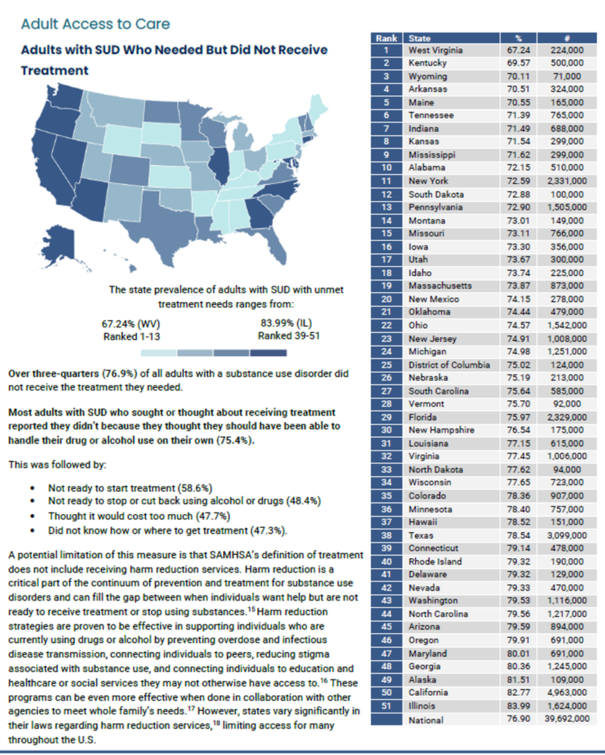
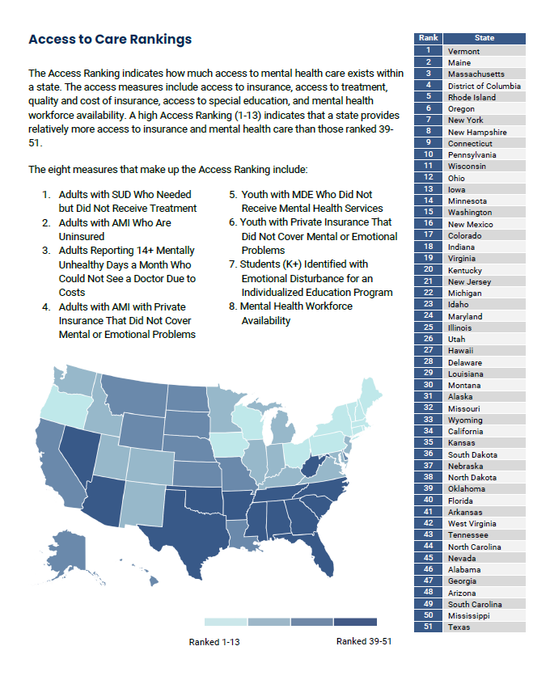
44
Notes:
Final thought
National Institute of Mental Health

Slide 34
“Never doubt that a small group of thoughtful, committed citizens can change the world; indeed, it’s the only thing that ever has.”
Margaret Mead

